Slide 1
Quantifying the Ambient Population
Nick Malleson, Tomas Crols, Molly Asher
http://surf.leeds.ac.uk/

Slide 2
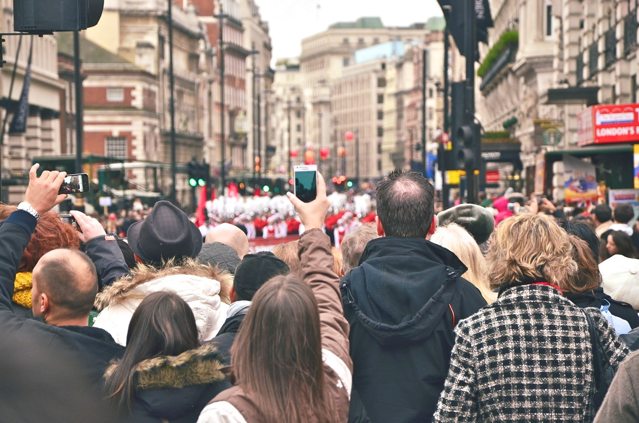
Quantifying the Ambient Population
How many people are there in Leicester Square right now?
Need to quantify the ambient population:
Crime – how many possible victims?
Pollution – who is being exposed? Where are the hotspots?
Economy – can we attract more people to our city centre?

Slide 3
Outline
Machine Learning for estimating footfall
Simulating Urban Flows
HABITS – Improving health policy with track & trace data
Molly Asher,
Simon Brereton
Tomas Crols
Susan Grant-Muller

Slide 4
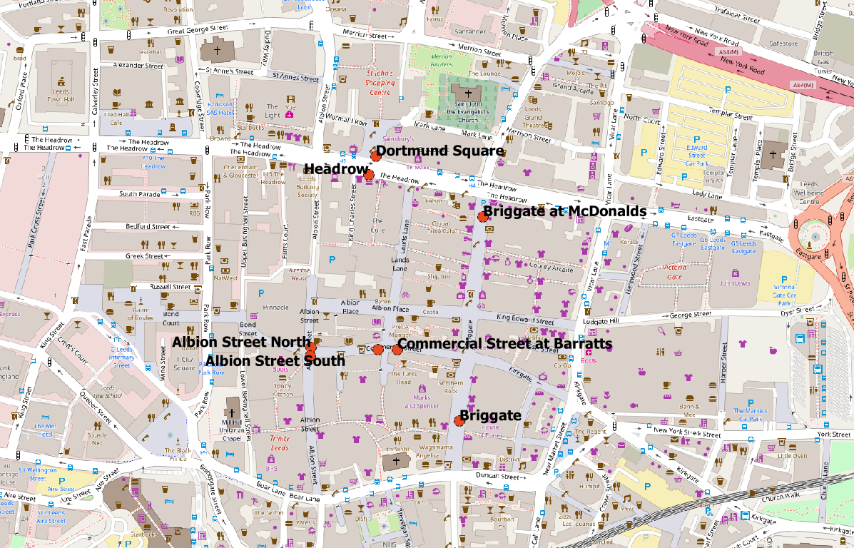
Machine Learning for Footfall
Leeds City Centre footfall cameras
Aggregate footfall counts per hour
7 years data
Publicly available https://datamillnorth.org/
Aims:
Understand drivers
Review & Predict
Random forest algorithm
Explanatory variables:
Weather; time of year; day of week; school / university holiday? etc.

Slide 5
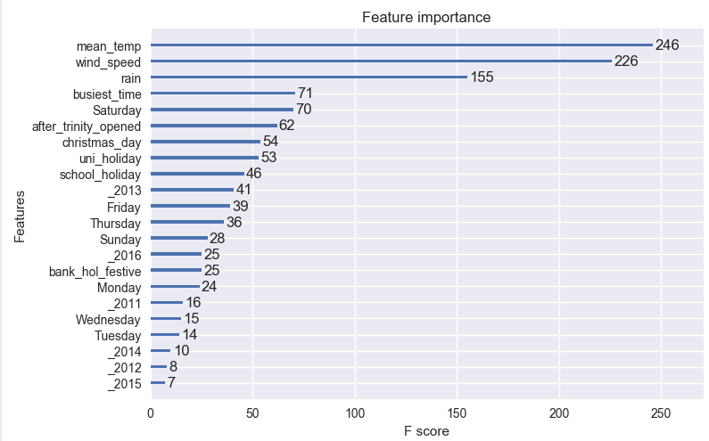

Slide 6
 | Actual | Estimate | Difference | %difference
21-Mar-13 | 279,473 | 187,381 | - 92,092 | -33
02-Apr-13 | 232,990 | 166,465 | - 66,525 | -29
27-Nov-15 | 286,810 | 204,984 | - 81,826 | -29
30-Nov-14 | 184,057 | 134,020 | - 50,037 | -27
28-Dec-11 | 283,715 | 206,793 | - 76,922 | -27
03-Jul-16 | 249,300 | 181,876 | - 67,424 | -27
02-Apr-11 | 288,469 | 211,071 | - 77,398 | -27
26-May-13 | 152,419 | 114,299 | - 38,120 | -25
17-Nov-13 | 162,311 | 122,312 | - 39,999 | -25
04-Apr-13 | 230,435 | 173,760 | - 56,675 | -25
23-Dec-11 | 286,607 | 216,589 | - 70,018 | -24
28-Nov-14 | 275,287 | 208,364 | - 66,923 | -24
02-Aug-15 | 146,423 | 111,007 | - 35,416 | -24
30-Apr-14 | 186,485 | 141,435 | - 45,050 | -24
28-Apr-11 | 224,526 | 171,172 | - 53,354 | -24
05-Apr-12 | 231,385 | 176,419 | - 54,966 | -24
27-Sep-16 | 244,564 | 187,986 | - 56,578 | -23
New shopping centre opening
Last weekend before December
Last weekend before December
Once it has been trained, the model can be used to forecast footfall.
The Met Office are predicting rain next Tuesday, what footfall can we expect?
Or to review previous events
We organised x on a warm Wednesday in May, did it increase footfall as much as we hoped it would?
Grand Départ 2014
Notes:
The mean centre is a spatial statistic which describes the mean X, Y coordinates of a set of features,

Slide 7

Simulating Urban Flows

Slide 8

Notes:
The Proposed Solution: How is this going to work?
‘Dynamic Data Assimilation’ methods
Widely used in other fields such as meteorology
Motivation: forecasters had insufficient observational data to initialise models, so combine short-term model forecasts with up-to-date observational data!
This process is repeated every (e.g.) 6 hours to make new forecasts.
Therefore the model forecasts use “all the available information, to determine as accurately as possible the state of [the system]” [104].
This makes it possible to more accurately represent the current state of the system, reducing uncertainty in future predictions
One of the main reasons that weather forecasts have improved so substantially in recent decades [56]
Example ABM:
This figure illustrates how DDA might be used to incorporate emerging ‘smart cities’ data (that describe the current state of a process in an urban system (e.g. the movement of people)) into an ABM to improve its forecast accuracy.

Slide 9
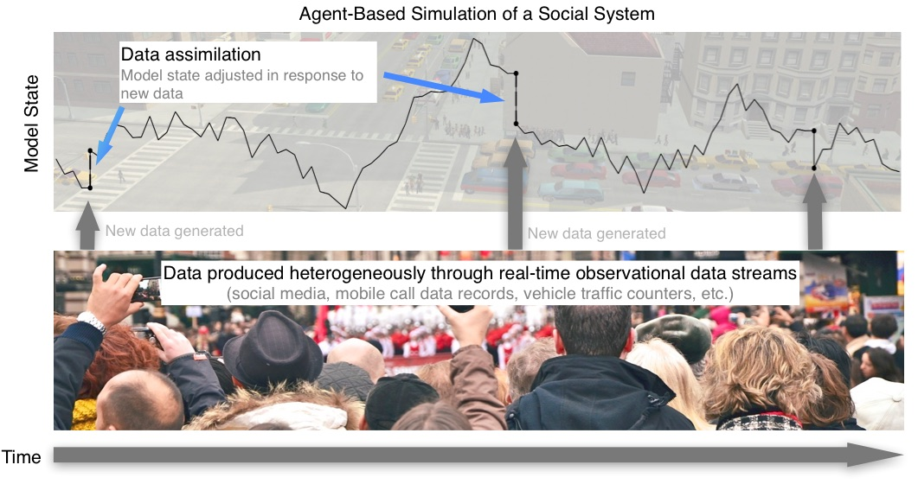
Simulating Urban Flows (www.surf.leeds.ac.uk)

Slide 10
Collaboration with Newcastle City Council
Aim: Investigate the benefits of linking track and trace activity data to support policies that:
Encourage active travel
Reduce the impacts of pollution
GoSmarter app
Market leader
Collect a large number of traces from residents (~100,000?)

Slide 11
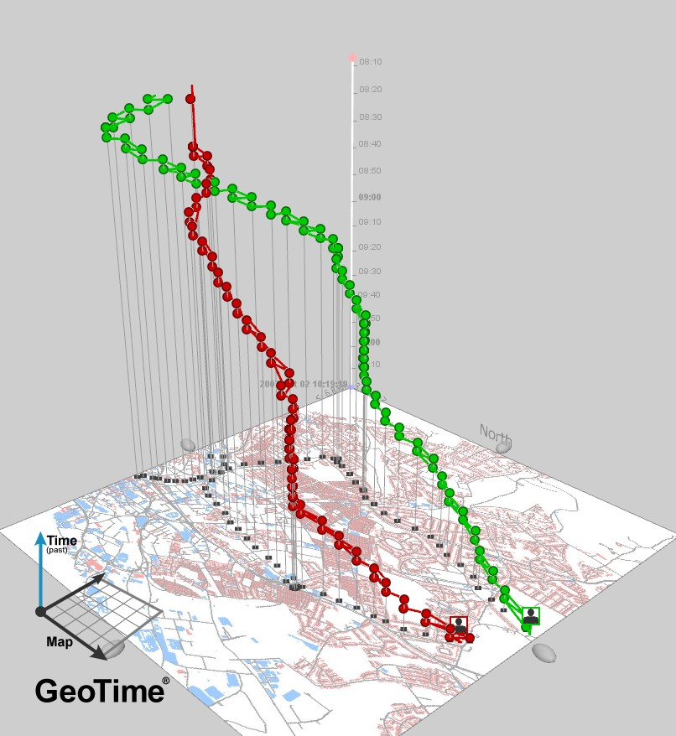
Source: Park, Yoo Min, and Mei-Po Kwan. 2017. “Individual Exposure Estimates May Be Erroneous When Spatiotemporal Variability of Air Pollution and Human Mobility Are Ignored.” Health & Place 43 (January): 85–94.

Slide 12
Quantifying the Ambient Population
Nick Malleson
http://nickmalleson.co.uk/
Machine Learning for estimating footfall
Simulating Urban Flows
http://surf.leeds.ac.uk/
HABITS – Improving health policy with track & trace data
Molly Asher, Simon Brereton
Tomas Crols
Susan Grant-Muller

